Slide 1


“Covid Precaution”
Faculty guide : Prof. Jaydeep Gheewala
Sarvajanik College of Engineering and Technology
Computer Engineering Department
BE IV Sem VII Shift 2
(2020-21)
Prepared and Presented by (Group No. : 11s2)
Bhutwala Bhargav (170420107506)
Jariwala Samarth (170420107521)
Khandwala Mudra (170420107527)
Mehta Sakshi (170420107534)
Patel Devarshi (170420107540)

Slide 2
Abstract
The use of masks is part of a comprehensive package of the prevention and control measures that can limit the spread of certain respiratory viral diseases, including COVID-19. Whether or not masks are used, physical distancing and other infection prevention and control (IPC) measures are critical to prevent human-to human transmission of COVID-19.
However, maintaining all such measures may require abundant amount of humanforce. The novelty of our system is that it will automate monitoring of face mask and identity recognition and monitor social distancing and hence reducing human labour. Moreover, record maintenance of staff and patients and thus providing bill transparency. Our intention is to implement this system in hospital wherein such measures will be taken care of through security camera and by using database.

Slide 3
Problem Definition
Knowing the current outbreak of Corona Virus the need for wearing mask and maintaining social distancing is critical at all the public places.
Hence, there is an utmost requirement of an automated system to detect the mask and maintain social distancing and verify authenticity of the person in hospitals. Moreover, for the covid patients the private hospitals are charging in lakhs for PPE kits, masks etc over the regular hospital service fee and with more than one doctor in charge of one patient the patient record maintenance system is required.

Slide 4
Feasible Solutions
Face mask detection : For the face mask detection system we are loading an input image from disk and then detecting the face in the image and then using our face mask detector to classify the image as either with mask or without mask.
Social distance monitoring : Applying object detection to detect all people (and only people) in a video stream and then computing pairwise distances between all detected people and then based on these distances, check the people who are not maintaining appropriate distance.
Face Recognition : Recognizing masked faces requires making a system that can identify the available datasets of a masked face, i.e., facial features. The advanced detection technology includes various facial features left uncovered, such as eyes, eyebrows, and the bridge of the nose.

Slide 5
Project Description
Modules of the system
Tools and technologies used
Implementation

Slide 6
Modules of the system
Face mask detection
Using Face Mask Detection System, Hospitals can monitor if their staff and patient are wearing masks or not. If anyone is found without mask it will be reported to the authority .
Social distancing monitoring
Monitoring social distancing in hospitals is crucial and no compromise should be made for the same hence this module claims to monitor the same using security camera and trigger alert if it is violated .

Slide 7
Modules of the system
Face Recognition
Once the face mask is detected it is necessary to authenticate and verify the individuals identity by extracting other facial features and matching them using computer vision.
Maintaining dashboard for check-in and out of Hospital Staff , resources used and bill transparency
With the verification of hospital staff we can maintain their profile and attendance , resources used by each doctor for each patient hence this will lead to utmost transparency in patient record maintenance and bill generation.

Slide 8
Tools and Technologies
Tkinter
OpenCV
Keras /Tensorflow
Python
Firebase or MySQL
PCA

Slide 9
Implementation
Machine Learning model (For the mask detection module)
We have used Convolutional Neural Networks(CNN) to train the dataset.
We have used Keras/tensorflow model to train our custom dataset.
For detecting the face we have used CAFFE model for object detection
we have used Keras and TensorFlow to train a classifier to automatically detect whether a person is wearing a mask or not.

Slide 10
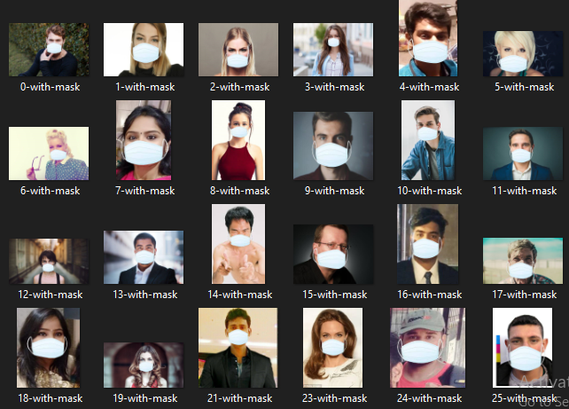
The dataset consists of 1,376 images belonging to two classes:
with_mask: 690 images

Slide 11
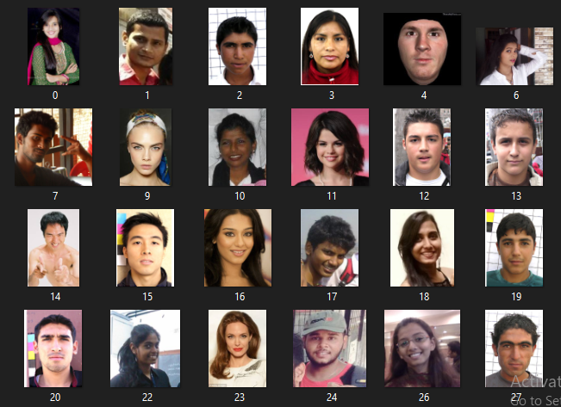
without_mask: 686 images

Slide 12
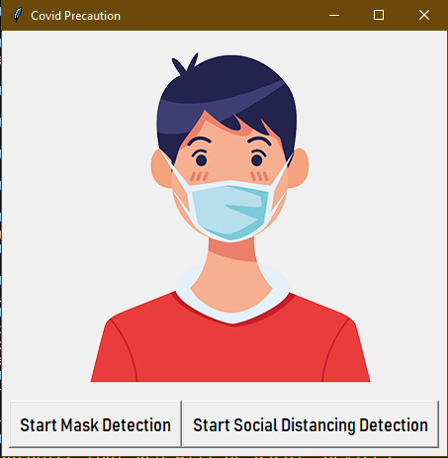
Application GUI
This is the first window panel as we start the execution wherein user is given two options to select.
Start mask detection
Start Social Distancing

Slide 13
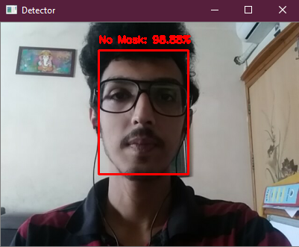
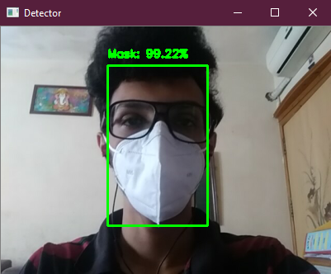
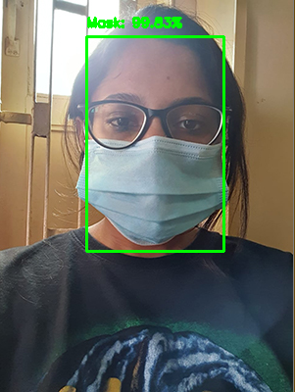
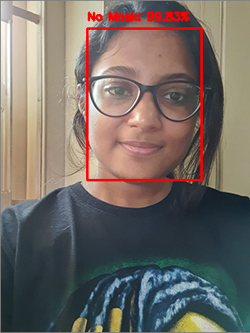
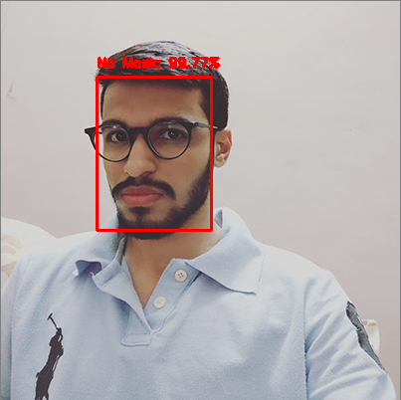
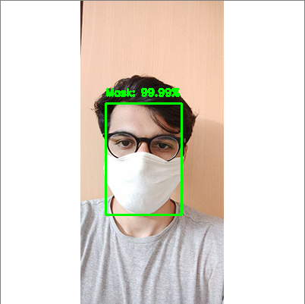
Output of the mask detector model

Slide 14
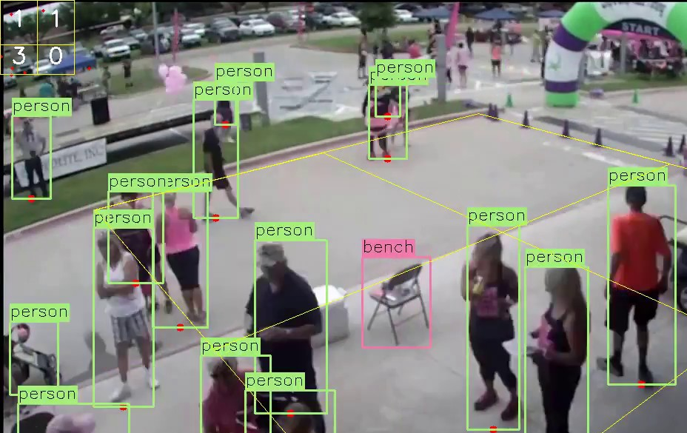
Social Distancing Detector
In this module , At first person detection is done with the help of Yolo-coco model and a centroid of the detected object i.e. Person is generated.

Slide 15
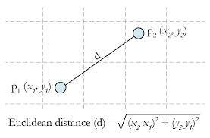
Then the distances between pairwise detected persons are calculated with the help of Euclidean Distance measuring formula.

Slide 16
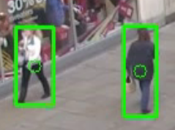
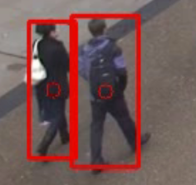
If the distance between two persons is 50 pixels apart it will turn the bounding box color to red and add it in the violations count.

Slide 17

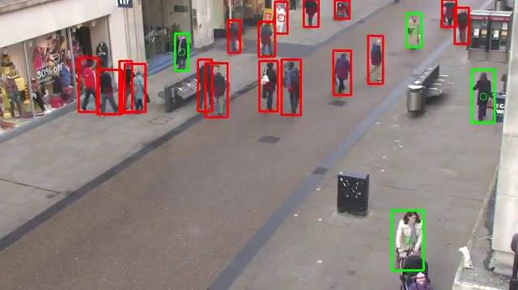
Output of the Social Distancing detector

Slide 18
Face Recognition
In this module we intend to recognise human face using PCA algorithm.
PCA (Principal Component Analysis) is a dimensionality reduction technique that was proposed by Pearson in 1901. It uses Eigenvalues and EigenVectors to reduce dimensionality and project a training sample/data on small feature space.
The jobs which PCA can do are prediction, redundancy removal, feature extraction, data compression, etc.
The main idea of using PCA for face recognition is to express the large 1-D vector of pixels constructed from 2-D facial image into the compact principal components of the feature space. This can be called eigenspace projection.

Slide 19
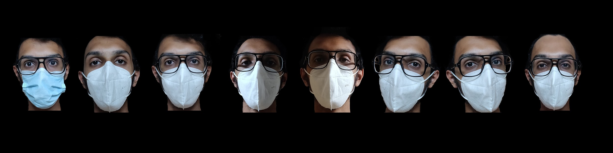
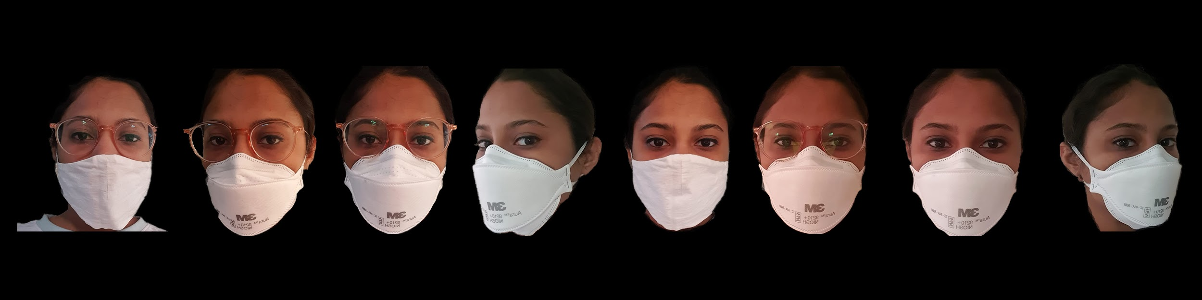
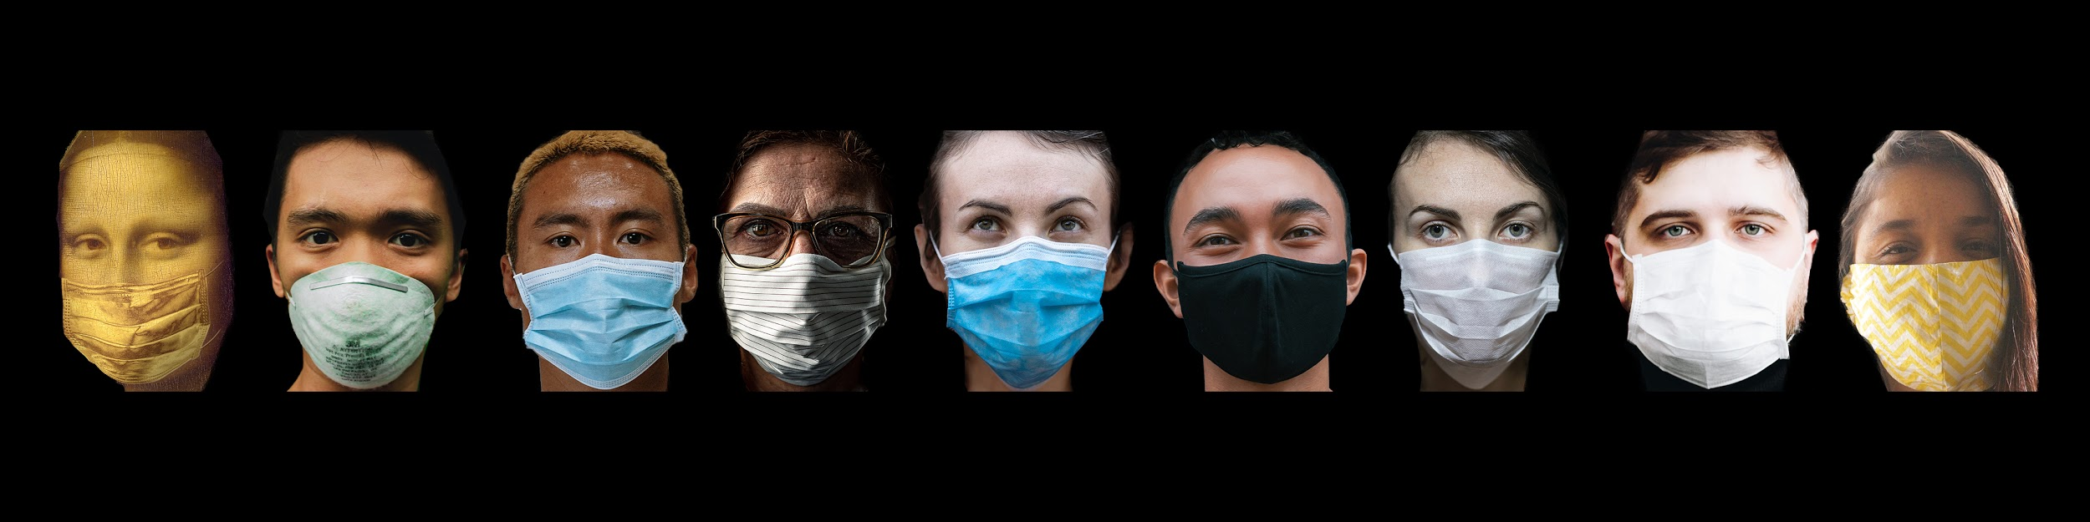
Step 1 : Preparing dataset

Slide 20
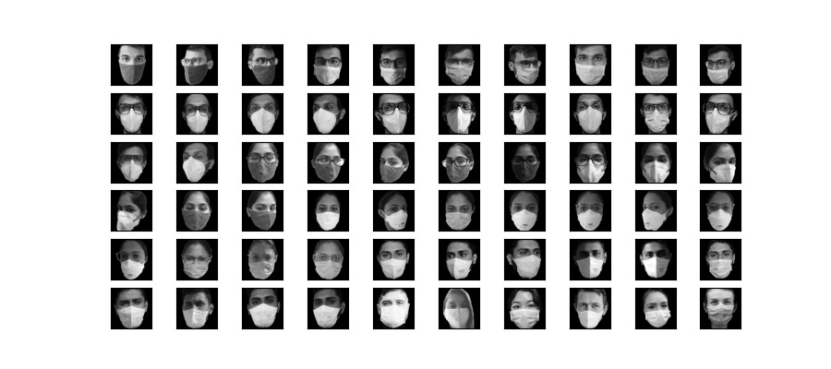

Slide 21
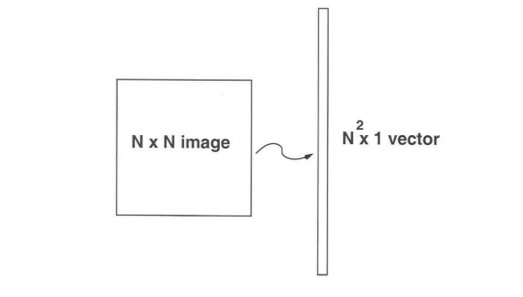
We first convert these images into vectors of size N2 such that:

Slide 22
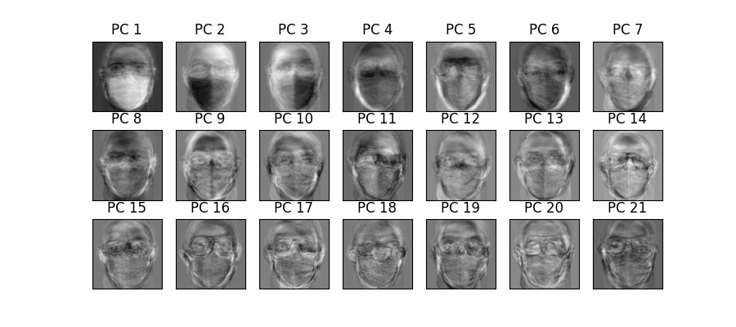
Step 2 : Applying PCA to dataset
These are some of the principle components.

Slide 23
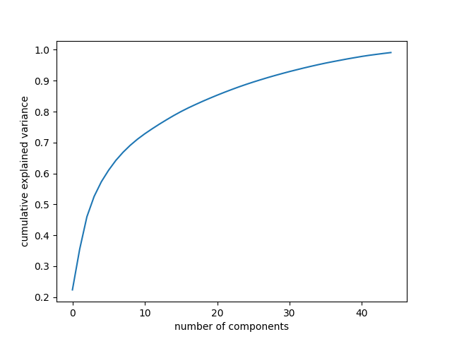
Step 3 : Selection of number of components
After applying PCA, we plot a graph like this and what we observe is that in the first few components we observe the maximum variance.

Slide 24
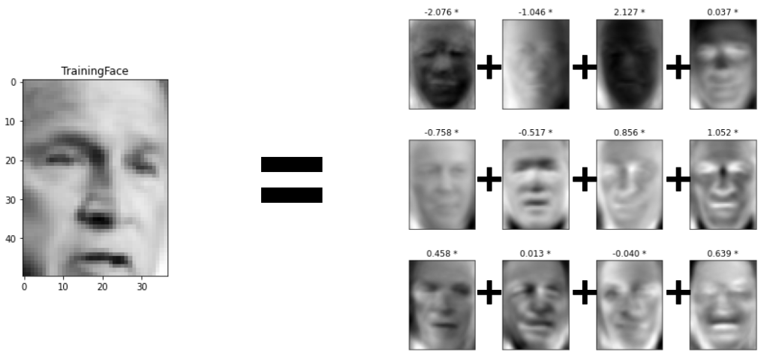
Step 4 : Project input images to Principal components
In this step, we take the coefficient of eigenfaces and represent the training faces in the form of a vector of those coefficients.
The input images re represented as weighted sum of individual weight multiplied by the eigen components.

Slide 25
Step 5 : Training classifier with reduced set of features
Here, if we have reduced set of features, our search space is reduced.
This helps in training machine learning models faster and results in the better accuracy in the real world scenario.
Step 6 : Apply PCA transformation to test input and predict using trained classifier
Once we apply PCA transform to test image we again get set of weights known as test weights.
The classifier deals with the similarity between the original weight and test weight.
If in the eigenspace the distance between weights are less, then we recognise them as same person.

Slide 26
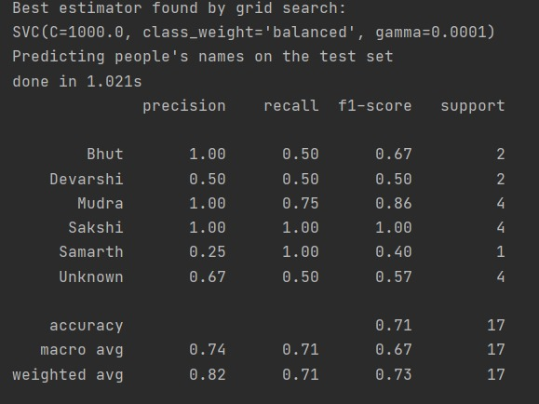
Output :

Slide 27
Software Requirement System (SRS)

Slide 28
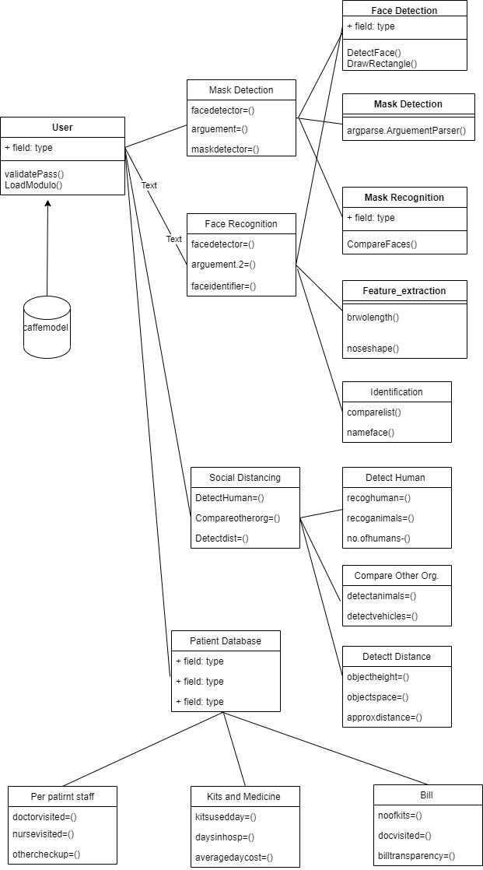
Class Diagram

Slide 29
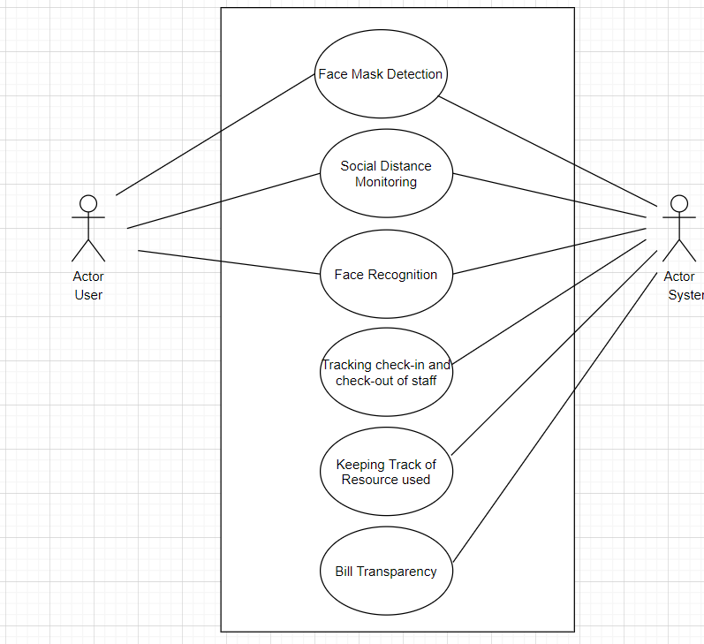
Use case Diagram

Slide 30
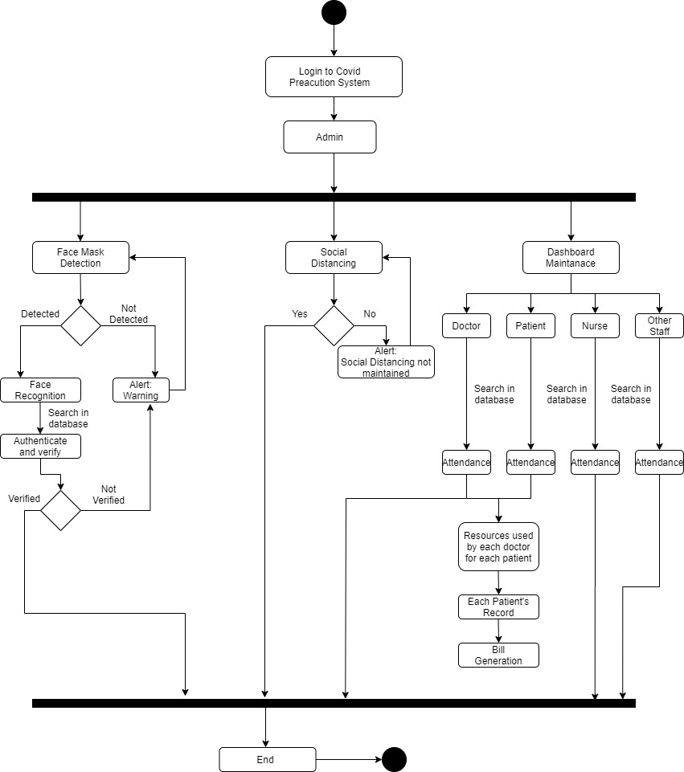
Activity Diagram

Slide 31
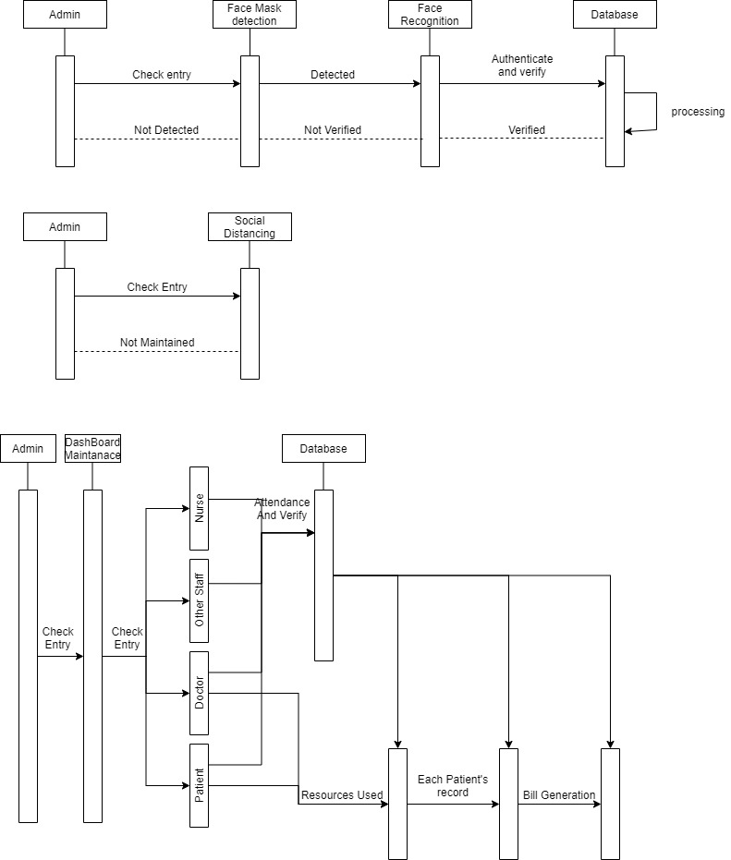
Sequential Diagram

Slide 32
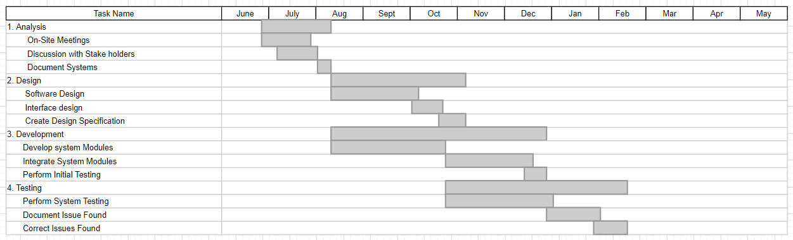
Gantt Chart

Slide 33
References
https://medium.com/@EbubekirBbr/biometric-verification-with-ml-1ebd56b5d181
https://www.pyimagesearch.com/2020/06/01/opencv-social-distancing-detector/
https://www.pyimagesearch.com/2020/05/04/covid-19-face-mask-detector-with-opencv-keras-tensorflow-and-deep-learning/
https://www.researchgate.net/publication/322222447_IRIS_RECOGNITION_SYSTEM
https://github.com/thuyngch/Iris-Recognition

Slide 34
Thank You

